Slide 1
MEGABOT
PIP104 PROFESSIONAL PRACTICE-II
VIVA-VOCE
Batch Number: CSE-G12
Roll Number | Name
20201CSE0109 | Ruchitha.M
20201CSE0165 | S. Apurva
20201CSE0130 | Chittepu Tejomai
20201CSE0084 | Shaik Ayesha Afrin
Under the Supervision of,
Mr. Jerrin Joe Francis
Assistant Professor
School of Computer Science Engineering & Information Science
Presidency University

Slide 2
Introduction
In today's rapidly evolving landscape of digital transformation, access to government-sponsored financial schemes has become increasingly vital for individuals and businesses alike. These financial initiatives are pivotal in fostering economic growth, aiding in disaster recovery, supporting agriculture and rural development, and promoting entrepreneurship
MegaBot harnesses the power of natural language processing and advanced search capabilities, making it a user-friendly virtual assistant that empowers individuals, entrepreneurs, and organizations to effortlessly find relevant information on loans, insurance plans, eligibility criteria, application procedures, and more. It offers a comprehensive, up-to-date resource that not only simplifies the process of accessing information but also aids in making well-informed decisions.
It will bridge the gap between government schemes and the people they are intended to serve, MegaBot represents a significant stride towards financial inclusion, efficiency, and empowerment. It paves the way for a future where all can access and leverage the financial support offered by government initiatives, ensuring that no one is left behind in this era of digital transformation. In essence, MegaBot is the gateway to a world of financial opportunity and prosperity.

Slide 3
Literature Review
Title | Authors | Overview
The Adoption and Implementation of Artificial Intelligence Chatbots in Public Organizations: Evidence from U.S. State Governments | Tzuhao Chen Mila Gascó-Hernandez and Marc Esteve | This research paper examines the adoption and implementation of AI chatbots in public organizations in the United States. The study finds that the adoption of chatbots is influenced by a number of factors, including the perceived relative advantage of chatbots, the ease of use of chatbots, and the leadership and innovative culture of the organization..
Consumer reaction to the use of artificial intelligence chatbot on distribution of general insurance in Singapore | Lai Hing TAN | The research paper "Consumer reaction to the use of artificial intelligence chatbot on distribution of general insurance in Singapore" by Lai Hing TAN examines consumer reactions to the use of AI chatbots in the distribution of general insurance in Singapore. The study finds that consumers are generally positive about the use of chatbots, but they also have some concerns

Slide 4
Krushi – The Farmer Chatbot | Mihir Momaya Anjnya Khanna Jessica Sadavarte Manoj Sankhe | The research paper "Krushi: A Conversational Agent for Indian Farmers" describes the development and evaluation of a chatbot named Krushi, which is designed to help Indian farmers access agricultural information and advice. Krushi is trained on a large corpus of farmer call center logs and is able to answer a wide range of questions, including those related to crop cultivation, pest and disease management, market prices, and government schemes.
FANCY (Financial Technology): Chatbot-Based Digital Financial Literacy Innovation As A Disability-Friendly Education Effort | Rizma Drajad Siti Apriyanti Maya Nur Oktaviani, Adinda Meisya Gina Eka Ningtyas Muhamad Catur Gunawan | This research paper describes the development and evaluation of a chatbot named FANCY, which is designed to help people with disabilities learn about financial literacy in a way that is accessible and engaging. FANCY is powered by artificial intelligence and is able to communicate with users in a natural language way.

Slide 5
Chatbots for E-Government: Opportunities and Challenges | V. V. Kumar et al | Chatbots are computer programs that can simulate conversation with humans. They are increasingly being used in a variety of applications, including e-government. Chatbots for e-government can provide citizens with 24/7 access to government services, simplify the process of applying for government services and tracking their status, and provide citizens with personalized information and support.
LOAN PAL – A CHATBOT TO PROFFERSPECIFICS ON LOAN SCHEMES | L. Jaba Sheela, Safrin P, Shanmugapriyaa P, and Sindhu S | LOAN PAL is an interactive chatbot that helps users clarify their doubts about government-provided loans and schemes. It is an Artificial Intelligence (AI) chatbot that pulls information from various government sources like NABARD, RBI, SBI, etc. It is mainly constructed using TensorFlow with Python.

Slide 6
THE ROLE OF QUALITY,TRUST AND EMPOWERMENT IN EXPLAINING SATISFACTION AND USE OF CHATBOTS IN E-GOVERNMENT | SHWETHA SINGH, YI-CHENG CHEN, XIN-LUO | Chatbots are increasingly being adopted by governments to provide citizens with information and services. However, little is known about the factors that influence citizen satisfaction with and use of chatbots in e-government. This study investigates the role of information quality, system quality, service quality, trust, and perceived empowerment in explaining citizen satisfaction with and use of chatbots in e-government.
Chatbots for E-Government: A Review of the Literature and Research Agenda | Yannis Charalabidis, Nikos Karacapilidis, Aggeliki Androutsopoulou | Chatbots are increasingly being adopted by governments to provide citizens with information and services. This paper reviews the research literature on chatbots for e-government and identifies a number of pros and cons of using chatbots in this context.

Slide 7
The influence of AI based chatbots and their design on user trust and information sharing in online loan applications | Naim Zierau Korbinian Flock Andreas Jansonc v Matthias Söllner Jan Marco Leimeister | "The Influence of AI-Based Chatbots and Their Design on Users' Trust and Information Sharing in Online Loan Applications" by Naim Zierau, Korbinian Flock, Andreas Janson, Matthias Söllner, and Jan Marco Leimeister explores the role of AI-powered chatbots in online loan applications, specifically focusing on how their design influences user trust and willingness to share sensitive information.
AI-based Chatbot Service for Financial Industry | Takuma Okuda, Sanae Shoda | The paper provides a comprehensive overview of AI-based chatbots and their potential applications in the financial industry. The paper identifies a number of benefits of using chatbots in the financial industry, including improved customer service, reduced costs, and increased efficiency.

Slide 8
Research Gaps Identified
For accessing information on government-sponsored loans and insurance schemes is fragmented and often challenging to navigate. Citizens and businesses must consult multiple sources, making it time-consuming and confusing. This lack of a centralized platform hinders the efficient dissemination of critical details and may discourage potential beneficiaries from utilizing these valuable resources.
Information Overload: The fragmentation leads to information overload, overwhelming users with a plethora of sources, making it difficult to find pertinent details.
Time-Consuming: Users must invest significant time in searching multiple platforms, causing delays in accessing vital information.
Confusion: Navigating various sources can be confusing, potentially leading to misinterpretation of eligibility criteria and application procedures.
Missed Opportunities: The lack of a centralized platform may result in users missing out on government-sponsored financial benefits they are entitled to.
Inefficiency: The absence of an integrated system decreases the efficiency of disseminating crucial information, hindering the government's efforts to promote these programs.

Slide 9
Proposed Methodology
The proposed method is an integrated platform designed to streamline access to various government-sponsored financial programs. It employs a chatbot interface that aggregates data from authoritative sources like NABARD and RBI, offering comprehensive information on loans and insurance schemes.
Advantages:
Centralized Access: The platform consolidates data, offering a one-stop destination for users to access diverse government-sponsored financial programs.
Time Efficiency: Users save time by avoiding the need to search multiple sources, ensuring swift access to essential information.

Slide 10
Clarity: The chatbot interface simplifies complex data, making it easier for users to understand eligibility, procedures, and benefits.
Enhanced Participation: Centralized information encourages more citizens and businesses to engage with government financial initiatives, promoting inclusivity.
Informed Decision-Making: Users can easily compare options and make informed choices, optimizing their use of government-sponsored loans and insurance schemes.

Slide 11
REQUIREMENT ANALYSIS
Hardware Components
Software Components
Hardware Components
Processor - I7/Intel Processor
Hard Disk - 160GB
Key Board - Standard Windows Keyboard
Mouse - Two or Three Button
Monitor - SVGA
RAM - 8GB
Software Requirements:
Operating System : Windows 11
Server-side Script : HTML, CSS ,JS&PHP
IDE/Workbench : Visual Studio Code

Slide 12
Objectives
The primary objective of this project is to create an interactive chatbot, "MegaBot," that serves as a centralized information hub for government-sponsored loans and insurance schemes.
It aims to provide easy access to comprehensive and up-to-date details from diverse sources like NABARD and RBI.
It improves customer satisfaction by providing quick and efficient responses to customer inquiries. They can also help customers to find the information they need more easily.

Slide 13
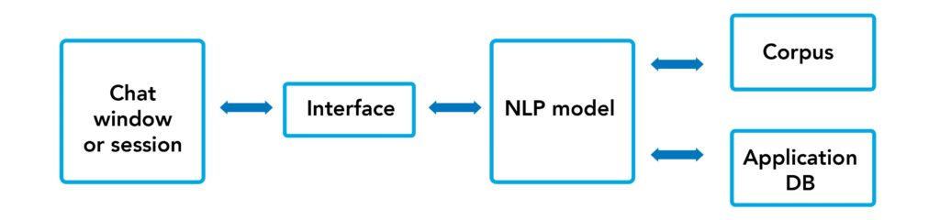
System Design & Implementation
Fig1 Architecture Diagram

Slide 14
The chat window or session is where the user interacts with the chatbot. The user types or speaks their query, and the chatbot responds.
The NLP model powers the chatbot's responses. It takes the user's input, analyzes it, and then generates a response.
The application is the software that runs the chatbot system. It includes the chat window, the NLP model, and other components, such as a database of knowledge.
The database stores the knowledge that the chatbot uses to answer questions. This could include facts, rules, and procedures.

Slide 15
Fig 2 Sequence diagram

Slide 16
A sequence diagram in Unified Modeling Language (UML) is a kind of interaction diagram that shows how processes operate with one another and in what order.
System is fed with data which is pre-processed to remove all the inaccuracies.
The model is trained with the pre-processed data.
Now the model is ready for the user.
User sends a request to the bot.
The bot reads the input query and answers it accordingly.

Slide 17
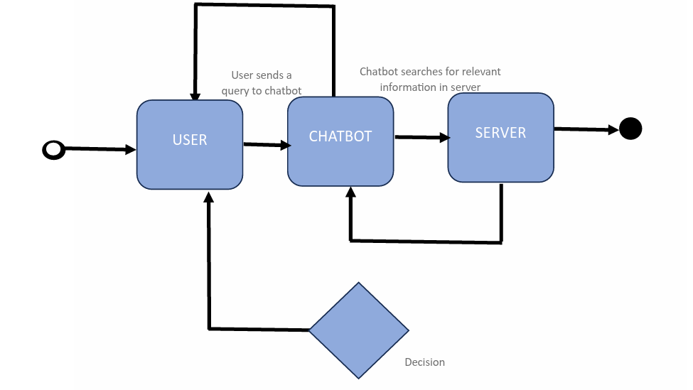
.
x
Fig 3 Activity diagram

Slide 18
Activities
User: sending a message, clicking a button, making a selection.
Chatbot: receiving a message, analyzing the input, searching for information from the server, generating a response and sending a response to user.
Decision box: The diamond in the diagram represents decision points where the chatbot needs to make a choice based on the user's input or the data it has access to.

Slide 19
MODULES
1. Registration.
Every user registers themselves by entering all the required fields like name, email address, password and repeat password.
The password has to match with repeated password.
Click on the submit button to register.
After entering all the details it will create an account for the user.
It allows the user to create a password for their email address for further login purposes.
If the user already has an account they can directly go to login page.

Slide 20
2. Login
Logins act as a gatekeeper, restricting access to specific resources or information to authorized users only.
This protects sensitive data from unauthorized access
Login credentials like usernames and passwords help secure individual accounts, safeguarding personal information and financial assets.
Logins provide a record of user activity, enabling tracking and ensuring accountability for actions taken within a system.
After entering the correct email address and password the user can log into web page to access the chatbot.
If the user email address and password do not match with registered details the user will not be allowed to log into the web page

Slide 21
3. Chatbot
After successfully logging in it will direct you to the home page there we will have a chatbot.
In the chatbot user can send a query and the chatbot will give a response accordingly.

Slide 22
4. Colorblind Accessebility
The webpage is built for the colorblind people to make it more inclusive.
Special colors are used in the ”colorblind mode” to make the webpage more accessible.

Slide 23
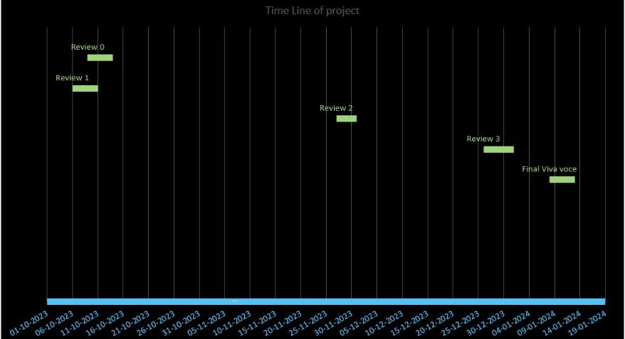
Timeline of Project

Slide 24
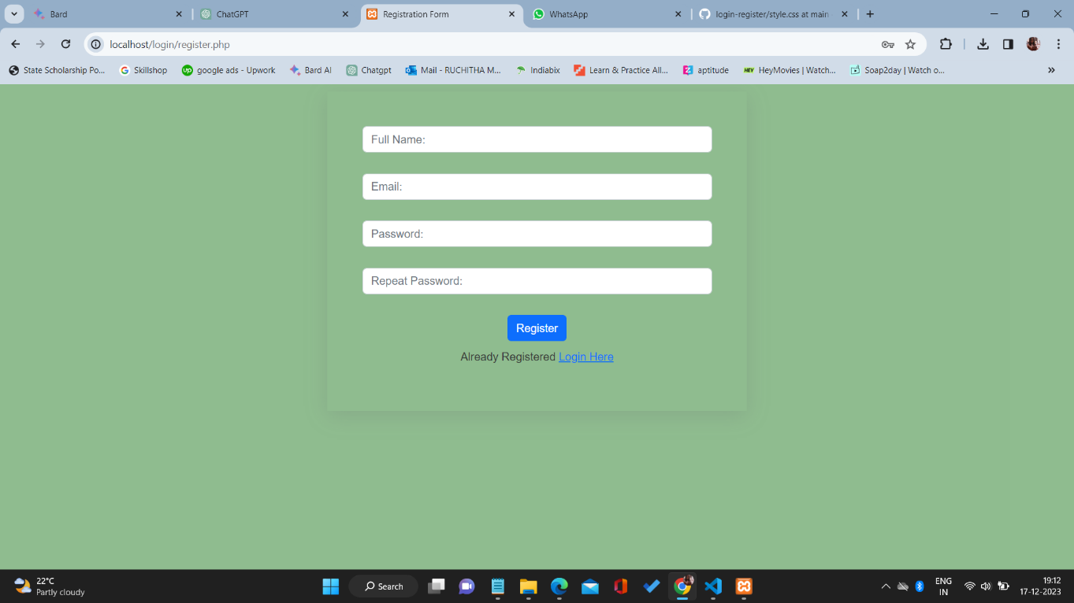
Outcomes / Results Obtained
Fig 4 Registration Page

Slide 25
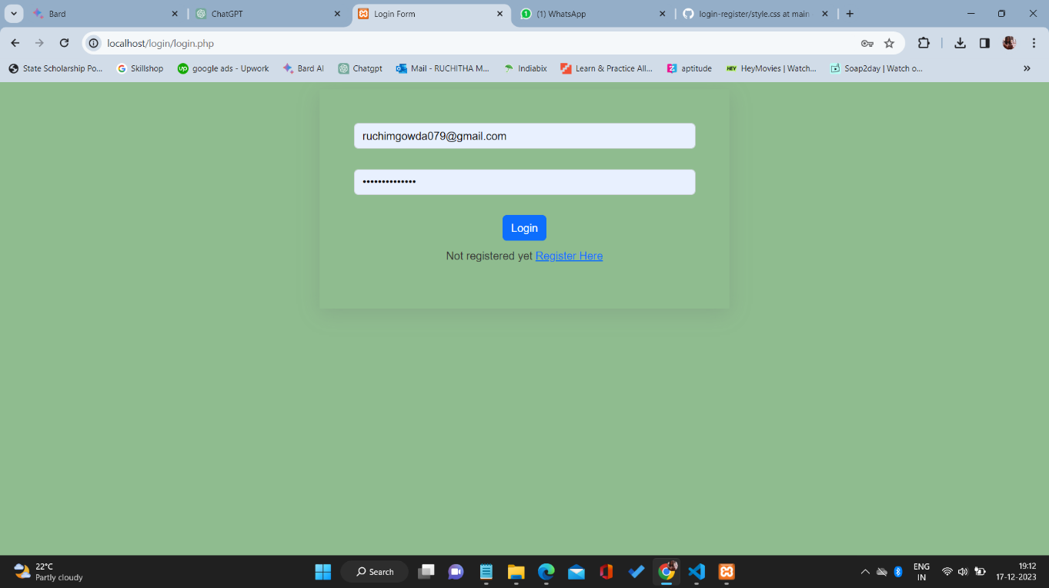
Fig 5 Login Page

Slide 26
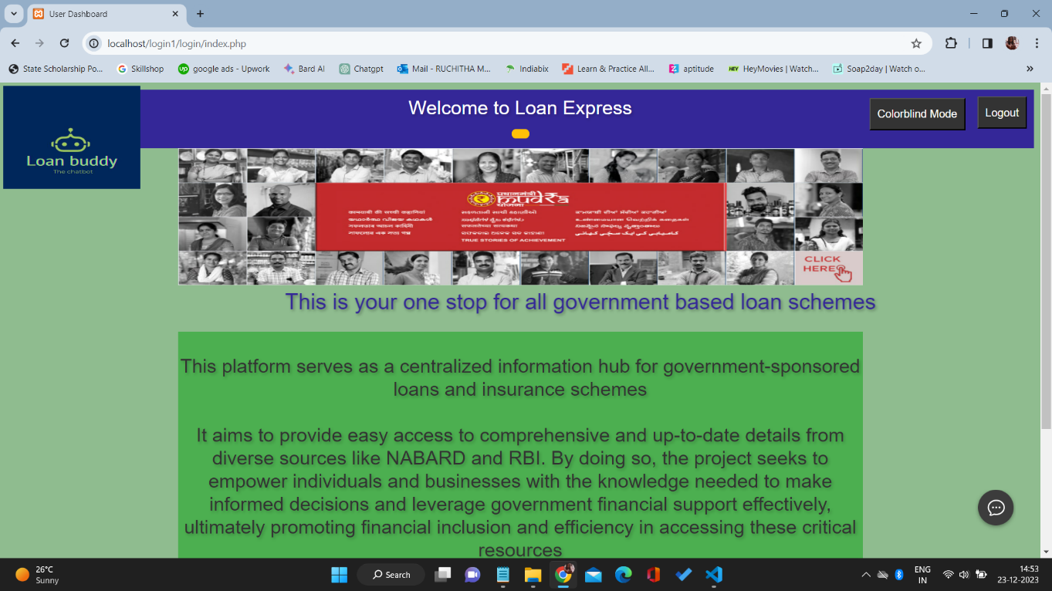
Fig 6 Web Page

Slide 27
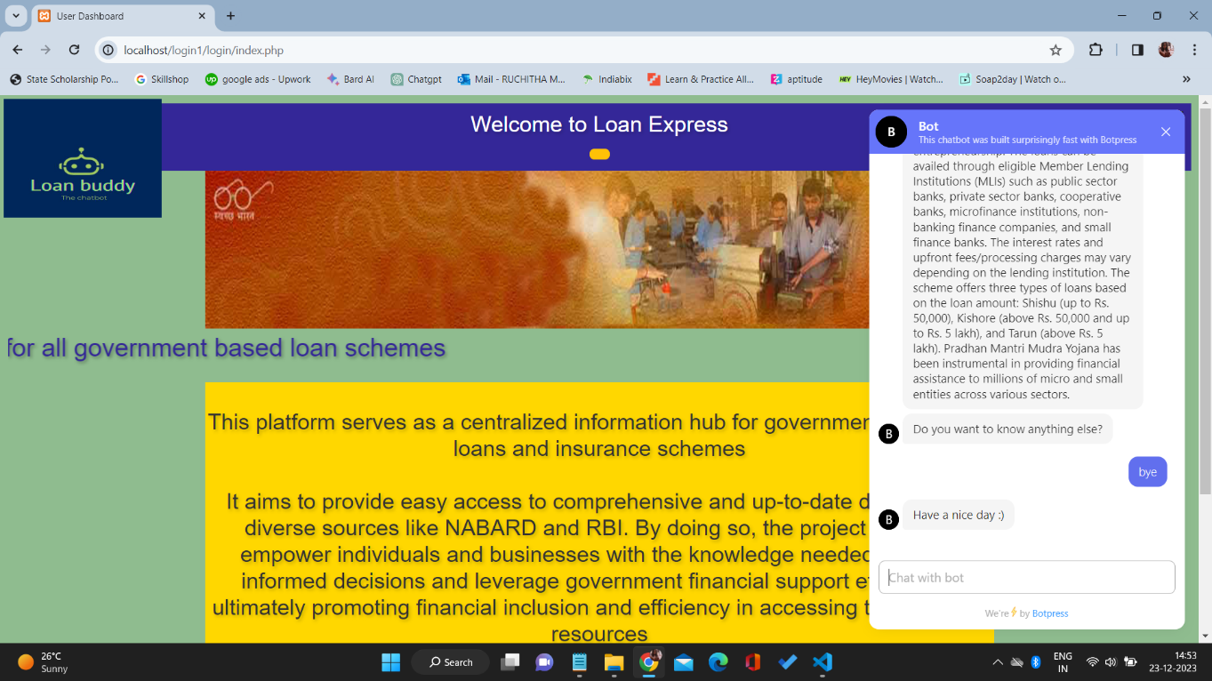
Fig 7 Colorblind Accessibility

Slide 28
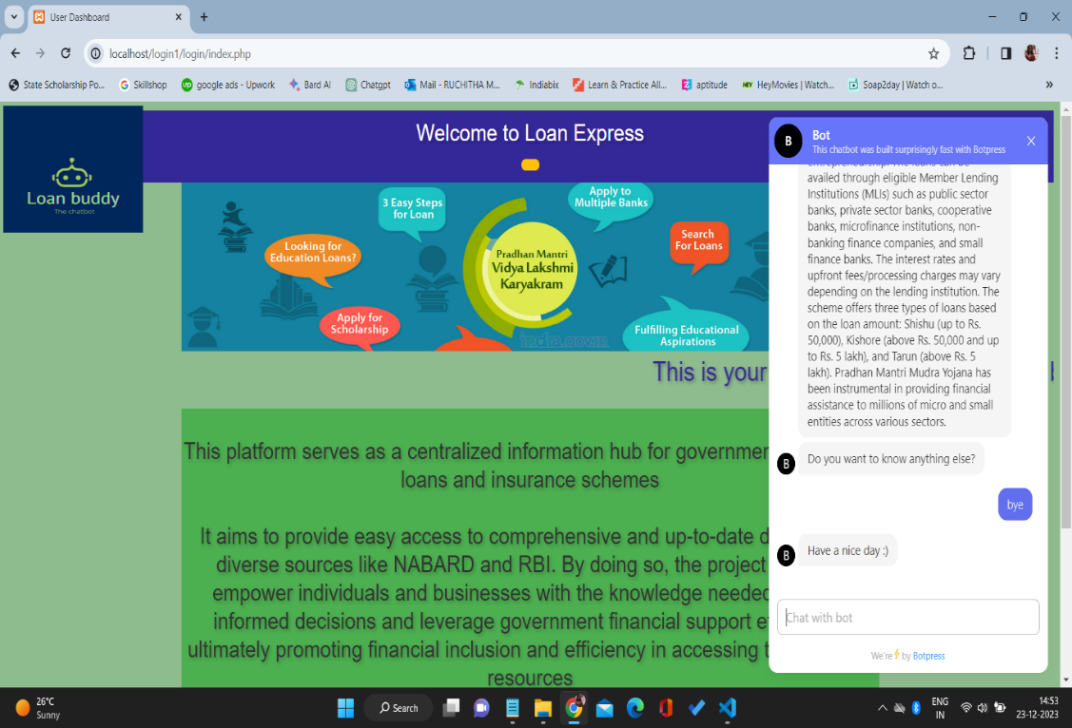
Fig 8 Chatbot

Slide 29
After entering the correct details the user will be directed to the webpage where he/she can use the chatbot to know all the government related loans/insurance schemes.
Chatbot provides 24/7 availability, handles routine inquiries, personalizes interactions, and resolves issues quickly, leading to increased customer satisfaction and loyalty.
Chatbots automate repetitive tasks, freeing up human agents for complex issues and reducing the need for additional staff, resulting in cost savings.
Chatbots can gather valuable customer data through interactions, providing insights into preferences and behaviors, which can be used for targeted marketing, product development, and improved service offerings.

Slide 30
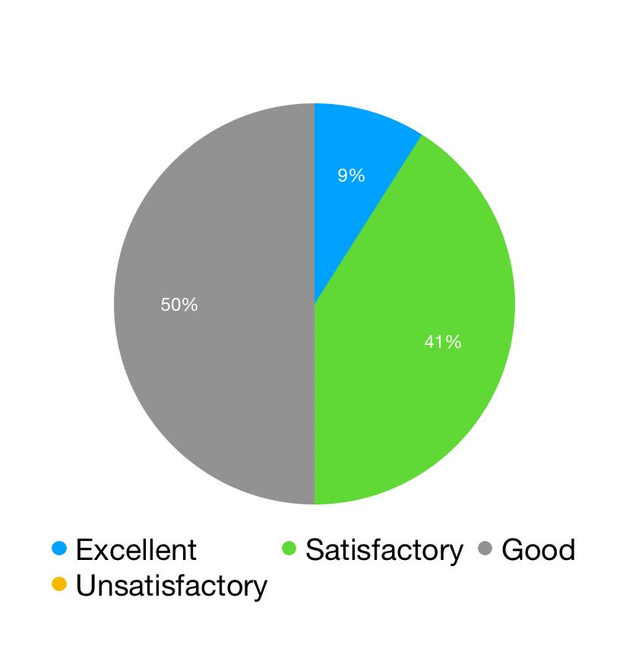
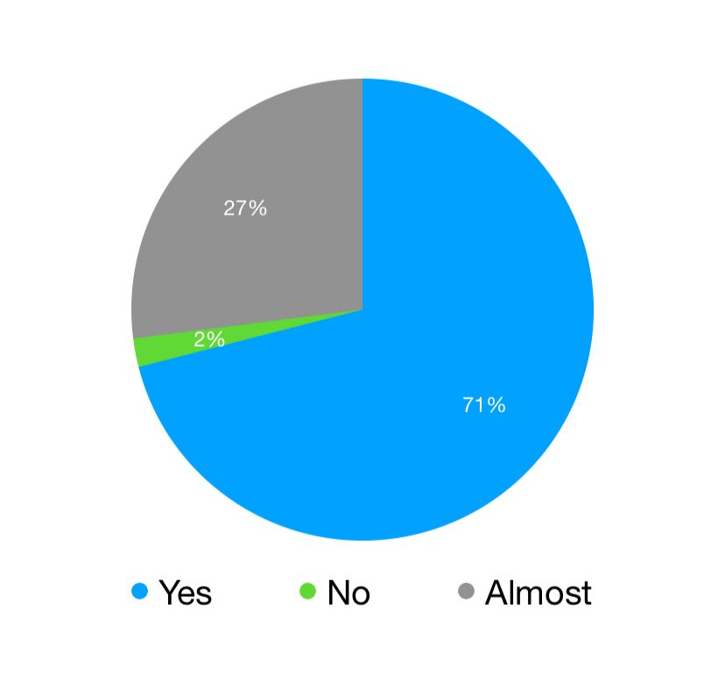
Feedback received from 10 users
Rate MegaBot’s functionality: Did MegaBot fulfil all its
(10 responses) functionalities? (10 responses)

Slide 31
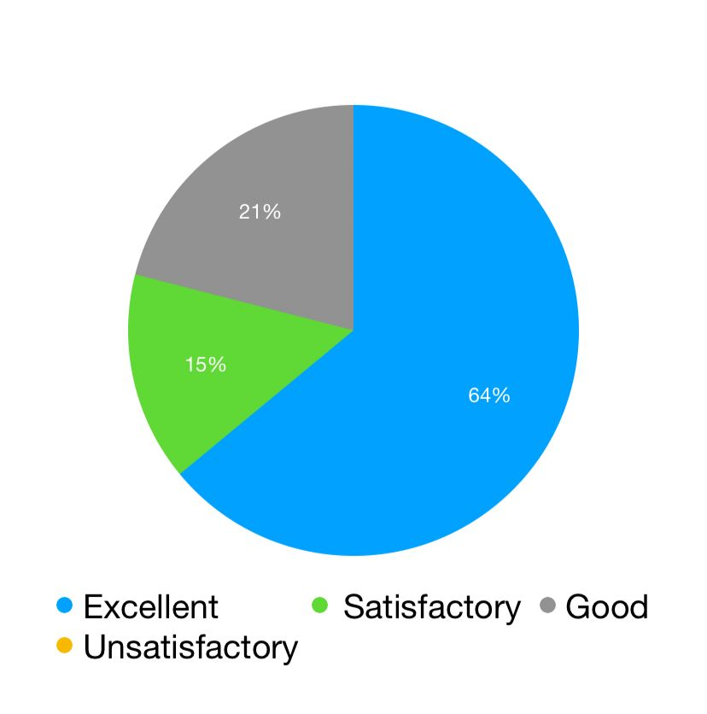
Ease of use (10 responses):

Slide 32
Conclusion
MegaBot emerges as a pivotal solution in the digital age, fostering financial inclusion and enhancing accessibility to government-sponsored financial schemes. By amalgamating information from diverse sources into a user-friendly virtual assistant.
MegaBot empowers individuals, businesses, and organizations to navigate the complex landscape of loans and insurance offerings seamlessly. Its advanced natural language processing and search capabilities provide a swift and efficient means to access vital details, thereby facilitating informed decision-making.
This innovative chatbot acts as a bridge, connecting government initiatives with the people they aim to serve.
Ultimately, MegaBot stands as a beacon of progress in the era of digital transformation, promoting financial inclusion and making government schemes more approachable and beneficial for a broader spectrum of citizens and entrepreneurs.

Slide 33
References
[1] Chen, T., Gascó-Hernandez, M., & Esteve, M. (2023). The Adoption and Implementation of Artificial Intelligence Chatbots in Public Organizations: Evidence from US State Governments. The American Review of Public Administration, 02750740231200522.
[2] TAN, L. H. (2023). Consumer reaction to the use of artificial intelligence chatbot on distribution of general insurance in Singapore.
[3] Momaya, M., Khanna, A., Sadavarte, J., & Sankhe, M. (2021, June). Krushi–the farmer chatbot. In 2021 International Conference on Communication information and Computing Technology (ICCICT) (pp. 1-6). IEEE.
[4] Apriyanti, R. D. S., Oktaviani, M. N., Gina, A. M., Ningtyas, E., Gunawan, M. C., Krawitan, U., & Sleman, K. (2023). FANCY (FINANCIAL TECHNOLOGY): CHATBOT-BASED DIGITAL FINANCIAL LITERACY INNOVATION AS A DISABILITY-FRIENDLY EDUCATION EFFORT. EXTENDED ABSTRACT e-BOOK, 75.
[5] V.V.Kumar et al, (2022). Chatbots for E-Government: Opportunities and Challenges 81(16), 22215-22246.
[6 LOAN PAL – A CHATBOT TO PROFFERSPECIFICS ON LOAN SCHEMES Dr. Jaba Sheela L1 ,Safrin P2 , Shanmugapriyaa P3, Sindhu S4 1Professor,Dept. of CSE, Panimalar Engineering College, Chennai , India 2,3,4 IV Yr Dept. of CSE, Panimalar Engineering College, Chennai , India International Journal of Applied Engineering Research ISSN 0973-4562 Volume 14, Number 11, 2019 (Special Issue)
[7] SHWETHA SINGH,YI-CHENG CHEN and XIN-LUO(2019), THE ROLE OF QUALITY,TRUST AND EMPOWERMENT IN EXPLAINING SATISFACTION AND USE OF CHATBOTS IN E-GOVERNMENT . International Journal of Applied Engineering Research, 14(9), 215-219.

Slide 34
[8] Yannis Charalabidis,Nikos Karacapilidis and Aggeliki Androutsopoulou(2013), Chatbots for E-Government: A Review of the Literature and Research Agenda. Government Information Quarterly, 40(4), 101877.
[9] Zierau, N., Flock, K., Janson, A., Söllner, M., & Leimeister, J. M. (2021). The influence of AI-based chatbots and their design on users’ trust and information sharing in online loan applications. In Hawaii International Conference on System Sciences (HICSS).-Koloa (Hawaii), USA.
[10] Okuda, T., & Shoda, S. (2018). AI-based chatbot service for financial industry. Fujitsu Scientific and Technical Journal, 54(2), 4-8.

Slide 35

Thank You

